Slide 1
Session 06 – GRC
MIS 6311-501 Cyber Security Fundamentals
Chris Davis

Slide 2
Housekeeping
Any Questions? Please do not hesitate to email. Or text.
Class Website: https://elearning.utdallas.edu
Dropbox: https://goo.gl/9AFyoE
UTD Email: cmd140430@utdallas.edu
Gmail: davischr2@gmail.com
Google Voice: 214-771-8122 (Text & Emergencies)
LinkedIn: www.LinkedIn.com/in/ChristopherDavis
Blog: www.cloudauditcontrols.com
Class: Monday 7:00pm-9:45pm JSOM 12.210

Slide 3

Academic Calendar & Sessions
TEST

Slide 4
Comparison of Our Class to CISSP Domains
Shon Harris Book – Chapters
Current CISSP Domains
2
Information Security Governance and Risk Management
8
Business Continuity and Disaster Recovery Planning
Security and Risk Management
9
Legal, Regulations, Investigations and Compliance
7
Cryptography
Security Engineering
4
Security Architecture and Design
Security Assessment and Testing
5
Physical (Environmental) Security
Asset Security
6
Telecommunications and Network Security
Communications and Network Security
3
Access Control
Identity and Access Management
11
Operations Security
Security Operations
10
Software Development Security
Software Development Security

Slide 5
Tales from the Crypt.
Practical Applications & Lessons Learned.

Slide 6
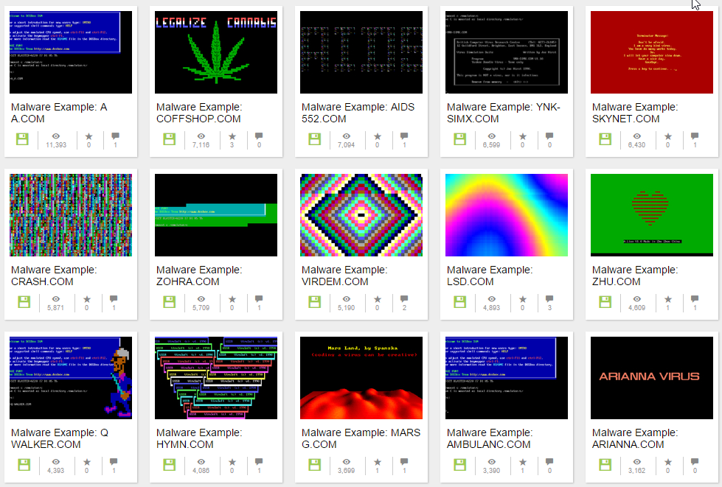
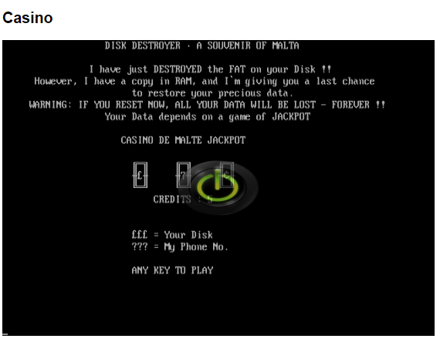
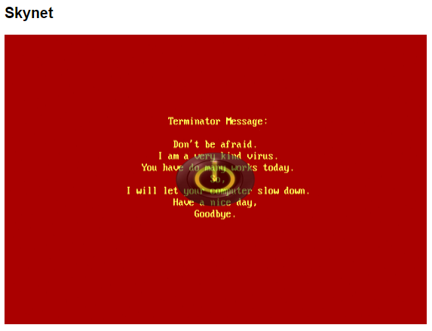
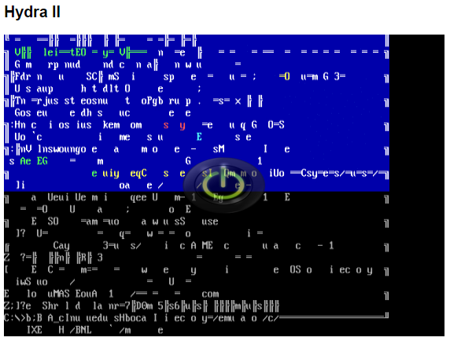

http://www.theregister.co.uk/2016/02/05/malware_museum/
78 Samples….. Safe Fun…… https://archive.org/details/malwaremuseum
Notes:
Casino
Casino was discovered in 1991, and it infects .COM programs, particularly COMMAND.COM. It is believed to have been written in Malta. When an infected executable is run, Casino installs itself quietly at the top of the PC's memory.
On January 15, April 15, and August 15, Casino will copy the hard drive's file system table into memory, delete the table from the disk, and force the user to play a slot machine game. If you hit the jackpot, the table is written back to the drive, so you get to keep your data intact. If you lose, Casino writes garbage to the file allocation table, destroying the file system unless you somehow manage to piece it back together with recovery tools.
Skynet
Skynet was developed in China and discovered in 1994. it infects programs, and stays resident in memory. When an infected .COM file is run, Skynet is triggered: it takes over the PC, displays a message reference kickass 1990s sci-fi flick The Terminator, and then slow your computer down – or make it randomly hang. Annoying if you're trying to get work done.
Hydra II
This is a classic old-school virus that would take over your screen and make all the letters and symbols swirl and cavort until there's nothing left on the display except a black oblivion – a terrifying experience if you're putting the finishing touches to an important document. The Hydra family of malware was discovered in 1991, and it infects .COM files. It doesn't do anything except replicate and fuel the imagination of Hollywood screenwriters.

Slide 7
Let’s Get Started.

Slide 8
POP QUIZ!!!
CHEATING!

Slide 9
Chris's View
… “GRC” Coined by Michael Rasmussen Feb 2002

Slide 10
Wait… Before We Get Started…
Note on Review…
Note on Materials…

Slide 11
Chapter 3: Information Security and Risk Management

Slide 12
Session Contents
This chapter presents the following:
Security terminology and principles • Protection control types • Security frameworks, models, standards, and best practices • Security enterprise architecture • Risk management • Security documentation • Information classification and protection • Security awareness training • Security governance
Notes:
Security terminology and principles • Protection control types • Security frameworks, models, standards, and best practices • Security enterprise architecture • Risk management • Security documentation • Information classification and protection • Security awareness training • Security governance
Harris, Shon (2012-11-08). CISSP All-in-One Exam Guide, 6th Edition (Kindle Locations 1007-1011). McGraw-Hill Education. Kindle Edition.

Slide 13

NIST Definitions

Slide 14
Key Terms – NIST
Confidentiality -- Preserving authorized restrictions on information access and disclosure, including means for protecting personal privacy and proprietary information.
SOURCE: SP 800-53; SP 800-53A; SP 800-18; SP 800-27; SP 800-60; SP 800-37; FIPS 200; FIPS 199; 44 U.S.C., Sec. 3542

Slide 15
Key Terms – NIST
Integrity -- Guarding against improper information modification or destruction, and includes ensuring information non-repudiation and authenticity.
SOURCE: SP 800-53; SP 800-53A; SP 800-18; SP 800-27; SP 800-37; SP 800-60; FIPS 200; FIPS 199; 44 U.S.C., Sec. 3542
Availability -- Ensuring timely and reliable access to and use of information.
SOURCE: SP 800-53; SP 800-53A; SP 800-27; SP 800-60; SP 800-37; FIPS 200; FIPS 199; 44 U.S.C., Sec. 3542

Slide 16
Key Terms – NIST
Accountability -- The security goal that generates the requirement for actions of an entity to be traced uniquely to that entity. This supports non-repudiation, deterrence, fault isolation, intrusion detection and prevention, and after-action recovery and legal action.
SOURCE: SP 800-27

Slide 17
Key Terms – NIST
Assurance -- Grounds for confidence that the other four security goals (integrity, availability, confidentiality, and accountability) have been adequately met by a specific implementation. “Adequately met” includes (1) functionality that performs correctly, (2) sufficient protection against unintentional errors (by users or software), and (3) sufficient resistance to intentional penetration or by-pass.
SOURCE: SP 800-27

Slide 18
Controls Review

Slide 19
Interchangeable Terms
The terms “control,” “countermeasure,” and “safeguard” are interchangeable terms.
They are mechanisms put into place to reduce risk.

Slide 20
Control Types
Controls are put into place to reduce the risk an organization faces, and they come in three main types:
Administrative controls are commonly referred to as “soft controls” because they are more management-oriented. Examples of administrative controls are security documentation, risk management, personnel security, and training.
Technical controls (also called logical controls) are software or hardware components, as in firewalls , IDS , encryption, identification and authentication mechanisms.
Physical controls are items put into place to protect facility, personnel, and resources. Examples of physical controls are security guards, locks, fencing, and lighting.

Slide 21
Control Implementations (functionalities)
Deterrent -- Intended to discourage a potential attacker
Preventive -- Intended to avoid an incident from occurring
Corrective -- Fixes components or systems after an incident has occurred
Recovery -- Intended to bring the environment back to regular operations
Detective -- Helps identify an incident’s activities and potentially an intruder
Compensating -- Controls that provide an alternative measure of control

Slide 22
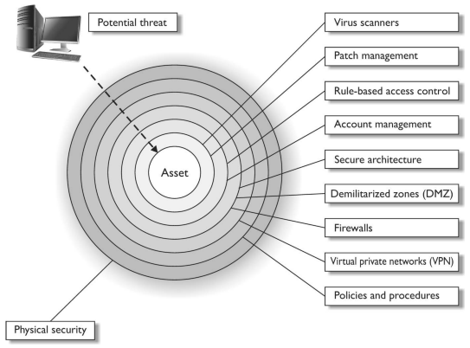
Defense-in-Depth: Layered Controls
Bad Actor
Layered Controls

Slide 23
Up to this point we know…
what we need to accomplish
(availability , integrity, confidentiality),
the tools we can use
(administrative, technical, physical controls)
how to talk about this issue
(vulnerability, threat, risk, control ).
(discussed later…)

Slide 24
Security Frameworks

Slide 25
About Security Frameworks
A security program is a framework made up of many entities: logical, administrative, and physical protection mechanisms, procedures, business processes, and people …that all work together to provide a protection level for an environment.
Each has an important place in the framework, and if one is missing or incomplete, the whole framework may be affected.
The program should work in layers: one layer provides support for the layer above it and protection for the layer below it.
Because a security program is a framework, organizations are free to plug in different types of technologies , methods, and procedures to accomplish the necessary protection level for their environment.

Slide 26
Many Standards, Best Practices, Frameworks
As you will see, various profit and nonprofit organizations have developed their own approaches… to security management , security control objectives, process management, and enterprise development.
We will briefly touch on their similarities and differences.

Slide 27
Standards, Practices, Frameworks (1/2)
Security Program Development
ISO/ IEC 27000 series -- International standards on how to develop and maintain an ISMS developed by ISO and IEC
Enterprise Architecture Development
Zachman framework -- Model for the development of enterprise architectures developed by John Zachman
TOGAF -- Model and methodology for the development of enterprise architectures developed by The Open Group
DoDAF -- U.S. Department of Defense architecture framework that ensures interoperability of systems to meet military mission goals
MODAF -- Architecture framework used mainly in military support missions developed by the British Ministry of Defence
Security Enterprise Architecture Development
SABSA model -- Model and methodology for the development of information security enterprise architectures

Slide 28
Standards, Practices, Frameworks (2/2)
Security Controls Development
CobiT -- Set of control objectives for IT management developed by Information Systems Audit and Control Association (ISACA) and the IT Governance Institute (ITGI)
SP 800-53 -- Set of controls to protect U.S. federal systems developed by the National Institute of Standards and Technology (NIST)
Corporate Governance
COSO -- Set of internal corporate controls to help reduce the risk of financial fraud developed by the Committee of Sponsoring Organizations (COSO) of the Treadway Commission
Process Management
ITIL -- Processes to allow for IT service management developed by the United Kingdom’s Office of Government Commerce
Six Sigma-- Business management strategy that can be used to carry out process improvement
Capability Maturity Model Integration (CMMI) -- Organizational development for process improvement developed by Carnegie Mellon

Slide 29
Why do you care about security programs?
Option 1: Firefighting
Option 2: Plan a Program
Organizations have a choice when attempting to secure their environment as a whole. They can just toss in products here and there, which are referred to as point solutions or stovepipe solutions, and hope the ad hoc approach magically works in a manner that secures the environment evenly and covers all of the organization’s vulnerabilities.
Or the organization can take the time to understand the environment , understand the security requirements of the business and environment, and lay out an overarching framework and strategy that maps the two together.

Slide 30
ISO/IEC 27000 Series

Slide 31
British Standard 7799
British Standard 7799 (BS7799) was developed in 1995 by the United Kingdom government’s Department of Trade and Industry and published by the British Standards Institution.
The standard outlines how an information security management system (ISMS ) (aka security program) should be built and maintained.
The goal was to provide guidance to organizations on how to design, implement , and maintain policies, processes, and technologies to manage risks to its sensitive information assets.

Slide 32
Centralize Management
The reason that this type of standard was even needed was to try and centrally manage the various security controls deployed throughout an organization.
Enterprise Governance
Common Objectives
Purposeful Planning
Without a security management system, the controls are implemented and managed in an ad hoc manner.
Before: The IT department would take care of technology security solutions, personnel security would be within the human relations department, physical security in the facilities department, and business continuity in the operations department.
We needed a way to oversee all of these items and knit them together in a holistic manner. This British standard met this need.
Objective:
Effective Governance.

Slide 33
BS 7799 Wide Coverage (1/2)
Information security policy for the organization -- Map of business objectives to security, management’s support, security goals, and responsibilities.
Creation of information security infrastructure -- Create and maintain an organizational security structure through the use of a security forum, a security officer, defining security responsibilities, authorization processes, outsourcing, and independent reviews.
Asset classification and control -- Develop a security infrastructure to protect organizational assets through accountability and inventory, classification, and handling procedures.
Personnel security -- Reduce risks that are inherent in human interaction by screening employees, defining roles and responsibilities, training employees properly, and documenting the ramifications of not meeting expectations.
Physical and environmental security -- Protect the organization’s assets by properly choosing a facility location, erecting and maintaining a security perimeter, implementing access control, and protecting equipment.

Slide 34
BS 7799 Wide Coverage (2/2)
Communications and operations management -- Carry out operations security through operational procedures, proper change control, incident handling, separation of duties, capacity planning, network management, and media handling.
Access control -- Control access to assets based on business requirements, user management, authentication methods, and monitoring.
System development and maintenance -- Implement security in all phases of a system’s lifetime through development of security requirements, cryptography, integrity protection, and software development procedures.
Business continuity management -- Counter disruptions of normal operations by using continuity planning and testing.
Compliance -- Comply with regulatory, contractual , and statutory requirements by using technical controls, system audits, and legal awareness.

Slide 35
More Frameworks…

Slide 36
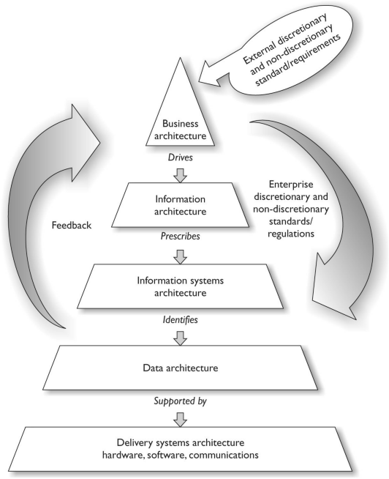
NIST Enterprise Architecture Framework
Good overview. Lacks detail.
Notes:
An enterprise architecture allows you to not only understand the company from several different views, but also understand how a change that takes place at one level will affect items at other levels. For example, if there is a new business requirement, how is it going to be supported at each level of the enterprise? What type of new information must be collected and processed? Do new applications need to be purchased or current ones modified? Are new data elements required? Will new networking devices be required? An architecture allows you to understand all the things that will need to change just to support one new business function. The architecture can be used in the opposite direction also. If a company is looking to do a technology refresh, will the new systems still support all of the necessary functions in the layers above the technology level?
Harris, Shon (2012-11-08). CISSP All-in-One Exam Guide, 6th Edition (Kindle Locations 1396-1402). McGraw-Hill Education. Kindle Edition.

Slide 37
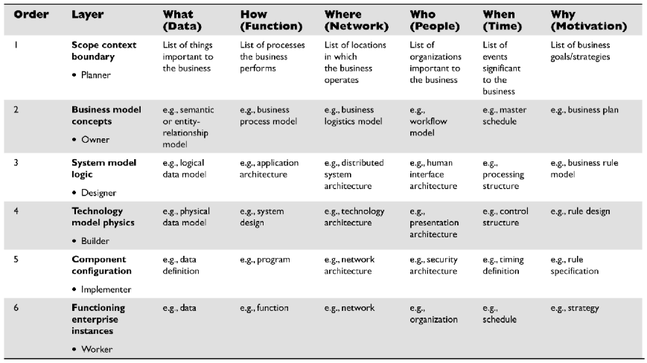
Zachman Architecture Framework
Good questions. Lacks context.
Notes:
The Zachman framework is a two-dimensional model that uses six basic communication interrogatives (What, How, Where, Who , When, and Why) intersecting with different viewpoints (Planner, Owner, Designer, Builder, Implementer, and Worker) to give a holistic understanding of the enterprise. This framework was developed in the 1980s and is based on the principles of classical business architecture that contain rules that govern an ordered set of relationships. The goal of this model is to be able to look at the same organization from different views (Planner, Owner, Designer, Builder, etc. ). Different groups within a company need the same information, but presented in ways that directly relate to their responsibilities. A CEO needs financial statements, scorecards, and balance sheets. A network administrator needs network schematics, a systems engineer needs interface requirements, and the operations department needs configuration requirements. If you have ever carried out a network-based vulnerability test, you know that you cannot tell the CEO that some systems are vulnerable to SYN-based attacks, or that the company software allows for client-side browser injections, or that some Windows-based applications are vulnerable to alternate data stream attacks. The CEO needs to know this information, but in a language he can understand. People at each level of the organization need information in a language and format that is most useful to them. A business enterprise architecture is used to optimize often fragmented processes (both manual and automated) into an integrated environment that is responsive to change and supportive of the business strategy. The Zachman framework has been around for many years and has been used by many organizations to build or better define their business environment. This framework is not security-oriented, but it is a good template to work with because it offers direction on how to understand an actual enterprise in a modular fashion.
Harris, Shon (2012-11-08). CISSP All-in-One Exam Guide, 6th Edition (Kindle Locations 1438-1452). McGraw-Hill Education. Kindle Edition.

Slide 38
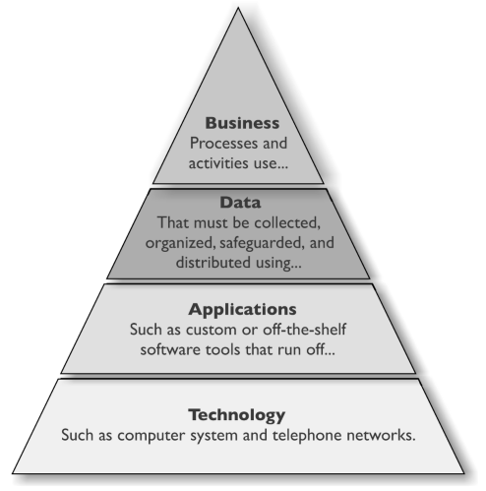
Open Group Architecture Framework
Good overview. Lacks detail.
Notes:
Another enterprise architecture framework is The Open Group Architecture Framework (TOGAF), which has its origins in the U.S. Department of Defense. It provides an approach to design, implement, and govern an enterprise information architecture. TOGAF is a framework that can be used to develop the following architecture types: • Business Architecture • Data Architecture • Applications Architecture • Technology Architecture So this architecture framework can be used to create individual architectures through the use of its Architecture Development Method (ADM). This method is an iterative and cyclic process that allows requirements to be continuously reviewed and the individual architectures updated as needed. These different architectures can allow a technology architect to understand the enterprise from four different views (business, data, application, and technology) so she can ensure her team develops the necessary technology to work within the environment and all the components that make up that environment and meet business requirements . The technology may need to span many different types of network types, interconnect with various software components, and work within different business units. As an analogy, when a new city is being constructed, people do not just start building houses here and there. Civil engineers lay out roads, bridges, waterways, and commercial and housing zoned areas. A large organization that has a distributed and heterogeneous environment that supports many different business functions can be as complex as a city. So before a programmer starts developing code, the architect of the software needs to be developed in the context of the organization it will work within.
Harris, Shon (2012-11-08). CISSP All-in-One Exam Guide, 6th Edition (Kindle Locations 1454-1468). McGraw-Hill Education. Kindle Edition.

Slide 39
DoDAF -- Department Of Defense Architecture Framework
When the U.S. DoD purchases technology products and weapon systems, enterprise architecture documents must be created based upon DoDAF standards to illustrate how they will properly integrate into the current infrastructures.
The focus of the architecture framework is on command, control, communications, computers, intelligence, surveillance, and reconnaissance systems and processes.
It is not only important that these different devices communicate using the same protocol types and interoperable software components, but also that they use the same data elements.
If an image is captured from a spy satellite, downloaded to a centralized data repository, and then loaded into a piece of software to direct an unmanned drone, the military personnel cannot have their operations interrupted because one piece of software cannot read another software’s data output.
The DoDAF helps ensure that all systems, processes, and personnel work in a concerted effort to accomplish its missions.
Good for...

Slide 40
MoDAF -- Ministry of Defense Architecture Framework
The British Ministry of Defence Architecture Framework (MODAF) is another recognized enterprise architecture framework based upon the DoDAF.
The crux of the framework is to be able to get data in the right format to the right people as soon as possible.
Modern warfare is complex, and activities happen fast, which requires personnel and systems to be more adaptable than ever before.
Data needs to be captured and properly presented so that decision makers understand complex issues quickly, which allows for fast and hopefully accurate decisions.
Good for...

Slide 41
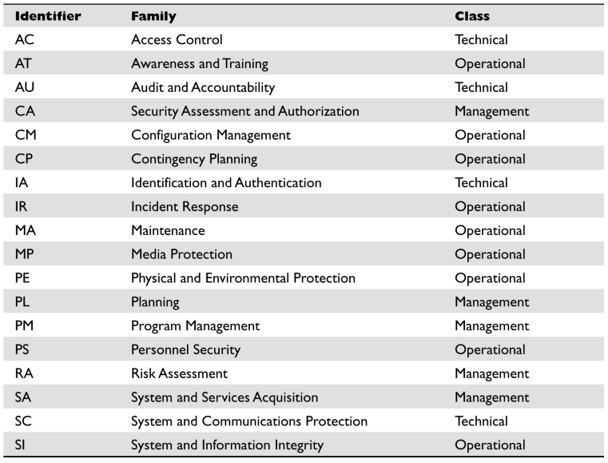
NIST 800-53
Getting Hot. Good.
Notes:
The control categories (families) are the management, operational, and technical controls prescribed for an information system to protect the confidentiality, integrity, and availability of the system and its information. Just as IS auditors in the commercial sector follow CobiT for their “checklist” approach to evaluating an organization’s compliancy with business-oriented regulations, government auditors use SP 800-53 as their “checklist” approach for ensuring that government agencies are compliant with government-oriented regulations. While these control objective checklists are different (CobiT versus SP 800-53), there is extensive overlap because systems and networks need to be protected in similar ways no matter what type of organization they reside in.
Harris, Shon (2012-11-08). CISSP All-in-One Exam Guide, 6th Edition (Kindle Locations 1673-1679). McGraw-Hill Education. Kindle Edition.

Slide 42
COSO Framework
Developed by the Committee of Sponsoring Organizations (COSO) of the Treadway Commission in 1985 to deal with fraudulent financial activities and reporting.
The COSO framework is made up of the following components:
Control environment • Management’s philosophy and operating style • Company culture as it pertains to ethics and fraud • Risk assessment • Establishment of risk objectives • Ability to manage internal and external change • Control activities • Policies, procedures, and practices put in place to mitigate risk • Information and communication • Structure that ensures that the right people get the right information at the right time • Monitoring • Detecting and responding to control deficiencies
COSO is a model for corporate governance, and CobiT is a model for IT governance.
Good conceptually. More to come.
Notes:
CobiT was derived from the COSO framework, developed by the Committee of Sponsoring Organizations (COSO) of the Treadway Commission in 1985 to deal with fraudulent financial activities and reporting. The COSO framework is made up of the following components: • Control environment • Management’s philosophy and operating style • Company culture as it pertains to ethics and fraud • Risk assessment • Establishment of risk objectives • Ability to manage internal and external change • Control activities • Policies, procedures, and practices put in place to mitigate risk • Information and communication • Structure that ensures that the right people get the right information at the right time • Monitoring • Detecting and responding to control deficiencies COSO is a model for corporate governance, and CobiT is a model for IT governance. COSO deals more at the strategic level, while CobiT focuses more at the operational level. You can think of CobiT as a way to meet many of the COSO objectives, but only from the IT perspective. COSO deals with non-IT items also, as in company culture, financial accounting principles, board of director responsibility, and internal communication structures. COSO was formed to provide sponsorship for the National Commission on Fraudulent Financial Reporting , an organization that studies deceptive financial reports and what elements lead to them. There have been laws in place since the 1970s that basically state that it was illegal for a corporation to cook its books (manipulate its revenue and earnings reports), but it took the Sarbanes-Oxley Act (SOX) of 2002 to really put teeth into those existing laws. SOX is a U.S. federal law that, among other things, could send executives to jail if it was discovered that their company was submitting fraudulent accounting findings to the Security Exchange Commission (SEC). SOX is based upon the COSO model, so for a corporation to be compliant with SOX, it has to follow the COSO model. Companies commonly implement ISO/ IEC 27000 standards and CobiT to help construct and maintain their internal COSO structure.
Harris, Shon (2012-11-08). CISSP All-in-One Exam Guide, 6th Edition (Kindle Locations 1683-1700). McGraw-Hill Education. Kindle Edition.

Slide 43
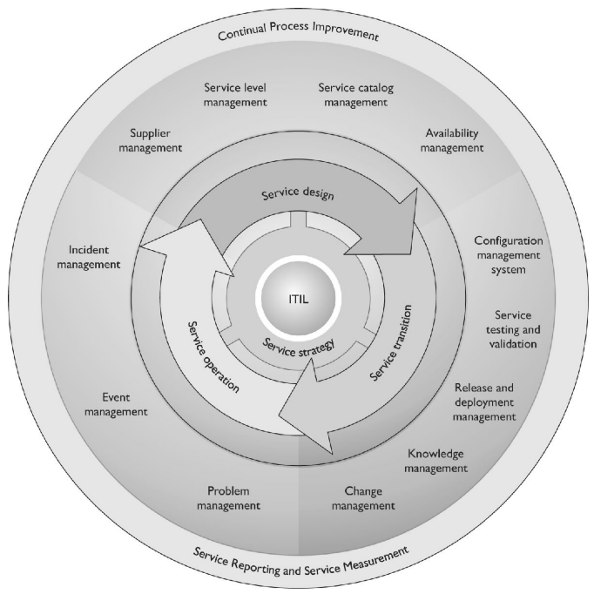
ITIL
Good conceptually.
Notes:
The Information Technology Infrastructure Library (ITIL) is the de facto standard of best practices for IT service management. ITIL was created because of the increased dependence on information technology to meet business needs. Unfortunately, a natural divide exists between business people and IT people in most organizations because they use different terminology and have different focuses within the organization. The lack of a common language and understanding of each other’s domain (business versus IT) has caused many companies to ineffectively blend their business objectives and IT functions. This improper blending usually generates confusion, miscommunication, missed deadlines, missed opportunities, increased cost in time and labor, and frustration on both the business and technical sides of the house. ITIL is a customizable framework that is provided in a set of books or in an online format. It provides the goals, the general activities necessary to achieve these goals, and the input and output values for each process required to meet these determined goals. Although ITIL has a component that deals with security, its focus is more toward internal service level agreements between the IT department and the “customers” it serves. The customers are usually internal departments. The main components that make up ITIL are illustrated in Figure 2-6 .
Harris, Shon (2012-11-08). CISSP All-in-One Exam Guide, 6th Edition (Kindle Locations 1707-1717). McGraw-Hill Education. Kindle Edition.

Slide 44
Six Sigma
Six Sigma was developed by Motorola with the goal of identifying and removing defects in its manufacturing processes.
The maturity of a process is described by a sigma rating, which indicates the percentage of defects that the process contains.
While it started in manufacturing, Six Sigma has been applied to many types of business functions, including information security and assurance.
Good conceptually.
Notes:
Six Sigma is a process improvement methodology. It is the “new and improved” Total Quality Management (TQM) that hit the business sector in the 1980s. Its goal is to improve process quality by using statistical methods of measuring operation efficiency and reducing variation, defects, and waste. Six Sigma is being used in the security assurance industry in some instances to measure the success factors of different controls and procedures. Six Sigma was developed by Motorola with the goal of identifying and removing defects in its manufacturing processes. The maturity of a process is described by a sigma rating, which indicates the percentage of defects that the process contains. While it started in manufacturing, Six Sigma has been applied to many types of business functions, including information security and assurance.
Harris, Shon (2012-11-08). CISSP All-in-One Exam Guide, 6th Edition (Kindle Locations 1720-1726). McGraw-Hill Education. Kindle Edition.

Slide 45
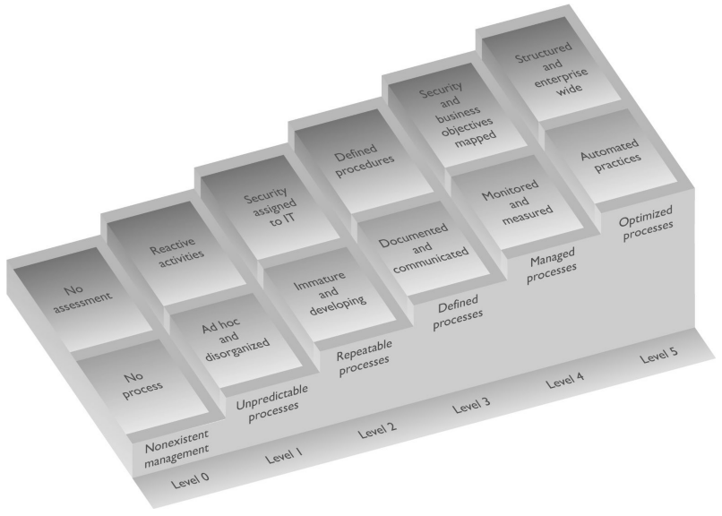
Capability Maturity Model Integration (CMMI)
Good conceptually. Metrics are critical.
Notes:
Capability Maturity Model Integration (CMMI) came from the security engineering world. We will covering it more in depth from that point of view in Chapter 10 , but this model is also used within organizations to help lay out a pathway of how incremental improvement can take place. While we know that we constantly need to make our security program better, it is not always easy to accomplish because “better” is a vague and nonquantifiable concept. The only way we can really improve is to know where we are starting from , where we need to go, and the steps we need to take in between. Every security program has a maturity level, which is illustrated in Figure 2-7 . Each maturity level within this CMMI model represents an evolutionary stage. Some security programs are chaotic, ad hoc, unpredictable, and usually insecure. Some security programs have documentation created, but the actual processes are not taking place. Some security programs are quite evolved, streamlined, efficient, and effective.
Harris, Shon (2012-11-08). CISSP All-in-One Exam Guide, 6th Edition (Kindle Locations 1728-1735). McGraw-Hill Education. Kindle Edition.

Slide 46
COBIT 5
Control Objectives for Information and related Technology (CobiT)

Slide 47
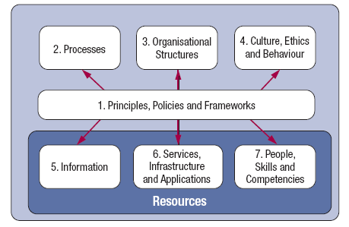
COBIT 5 Enablers
Source: COBIT® 5, figure 12. © 2012 ISACA® All rights reserved.

Slide 48
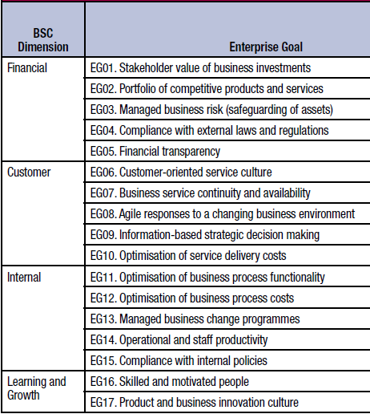
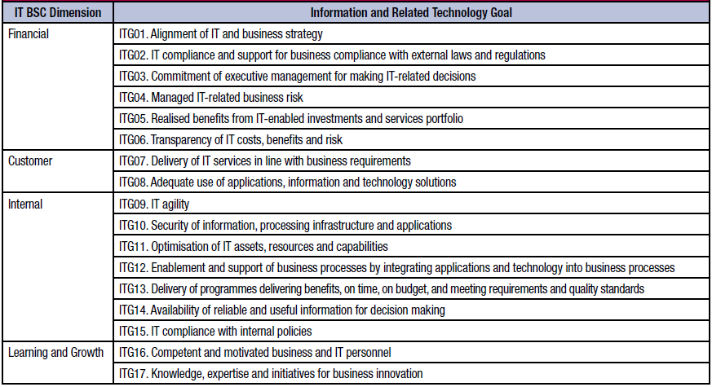
Enterprise vs. IT Goals

Slide 49
COBIT 5 Example
Using COBIT to address Regulatory Compliance

Slide 50
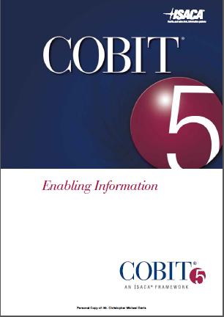
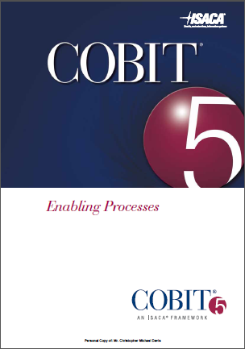
Intersecting Documents

Slide 51
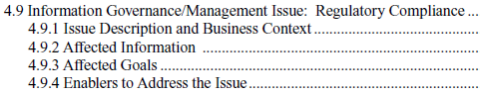
Addressing Information Governance and Management Issues Using COBIT 5
Enabling Information addresses the following example governance and management issues:
Demand-Side/Use of Information
Marketing Situational Awareness
Fraud Detection
IT Predictive Analytics
Master and Reference Data Management
End-User Computing
Disintermediation
Regulatory Compliance
Privacy

Slide 52
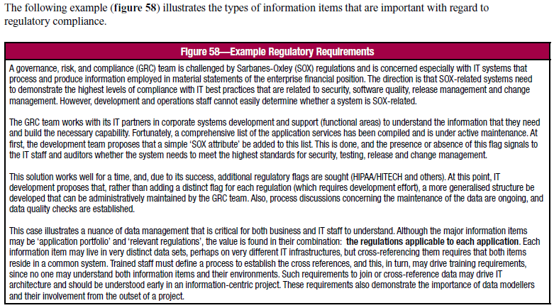
Example Regulatory Requirements

Slide 53
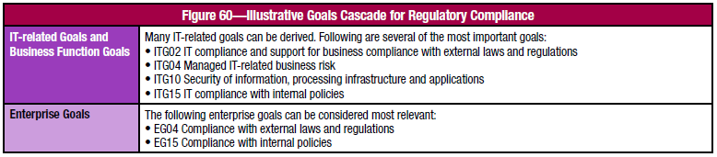
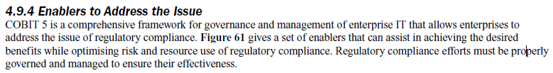
Illustrative Goals Cascade for Regulatory Compliance

Slide 54
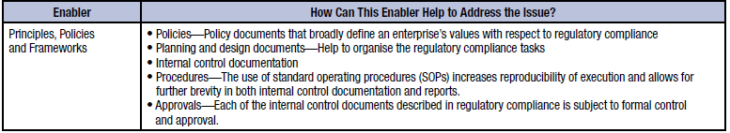
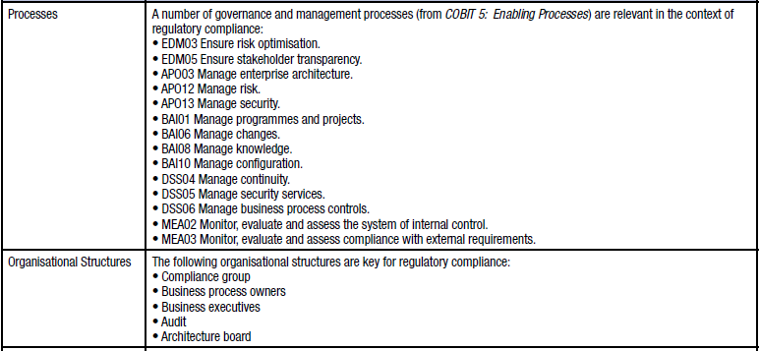
Illustrative Set of Enablers for Regulatory Compliance (1/3)

Slide 55
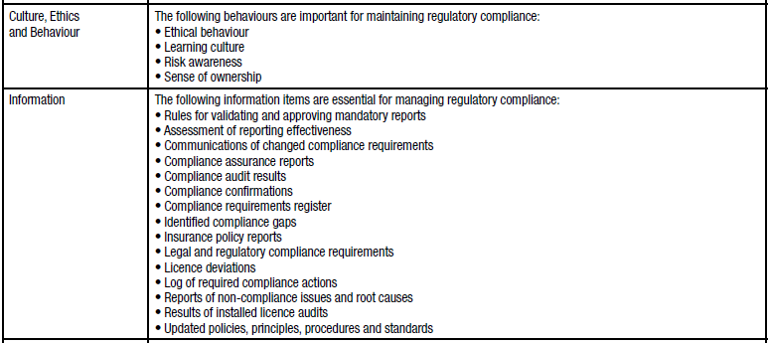
Illustrative Set of Enablers for Regulatory Compliance (2/3)

Slide 56
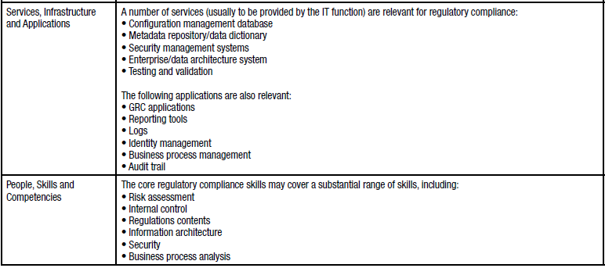
Illustrative Set of Enablers for Regulatory Compliance (3/3)

Slide 57
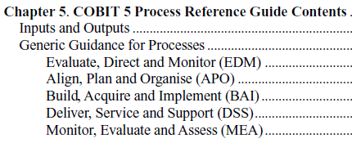
Finding Key Practices for each Process for each Domain inside COBIT 5 Enabling Processes
Enabling Processes covers process guidance for the following 5 domains:
Evaluate, Direct and Monitor (EDM)
Align, Plan and Organise (APO)
Build, Acquire and Implement (BAI)
Deliver, Service and Support (DSS)
Monitor, Evaluate and Assess (MEA)

Slide 58
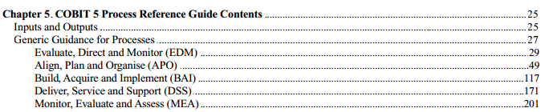
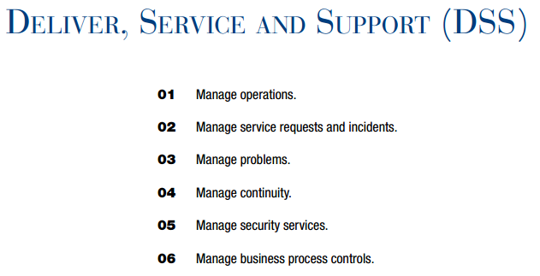
Navigating Domains to Processes
DOMAIN
Deliver, Service and Support
PROCESS
DSS05 Manage Security Services
COBIT5-Enabling-English.pdf

Slide 59
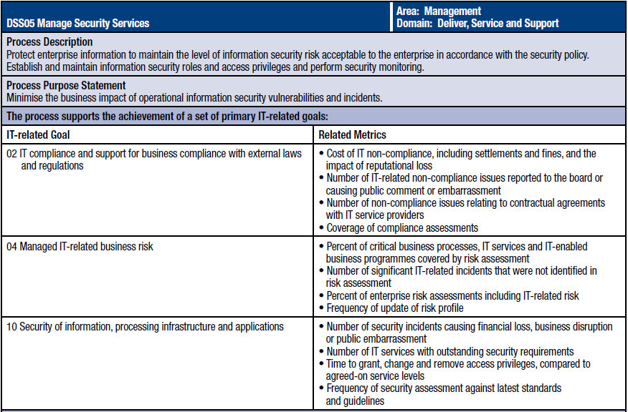
Processes and IT Goals

Slide 60
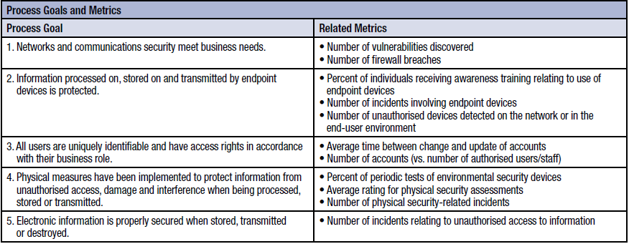
Processes and Process Goals

Slide 61
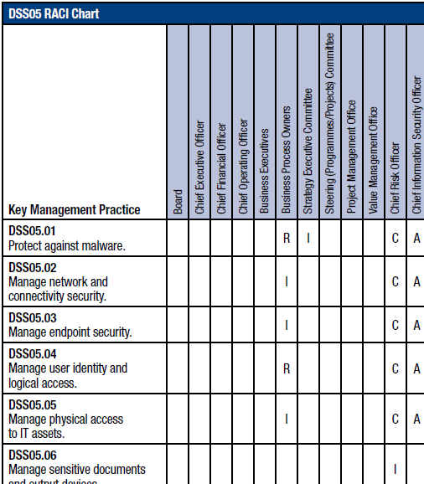
Key Management Practices Support Processes
PROCESS
DSS05 Manage Security Services
Key Management Practice
DSS05.01 Protect against malware.

Slide 62
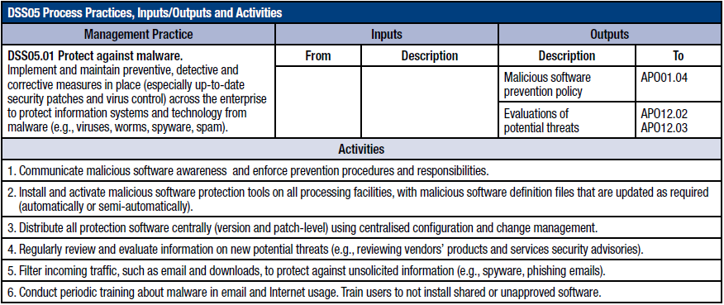
Key Management Practice – Details

Slide 63
Controls-and-Assurance-Cloud-COBIT-5

Slide 64
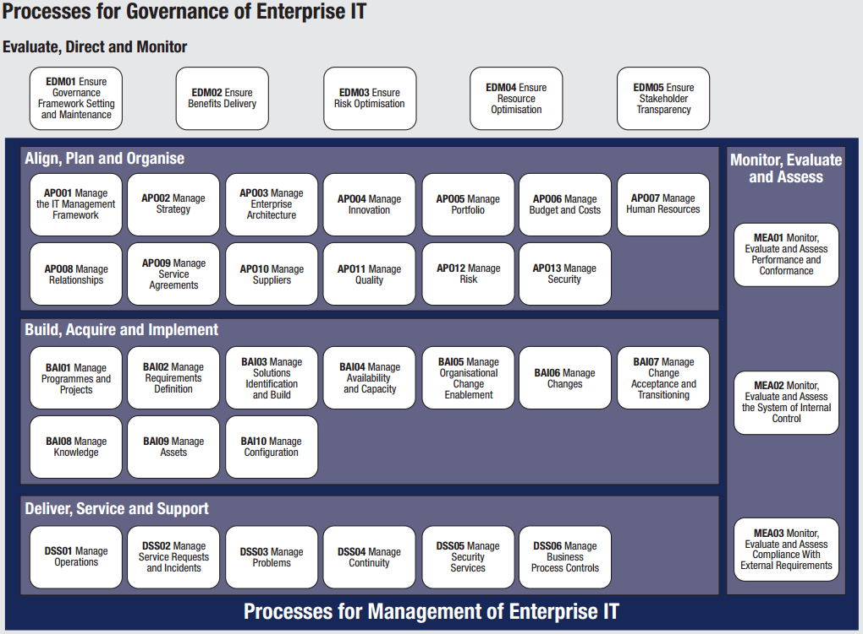
Remember Processes
Source: COBIT® 5, figure 16. © 2012 ISACA® All rights reserved.

Slide 65
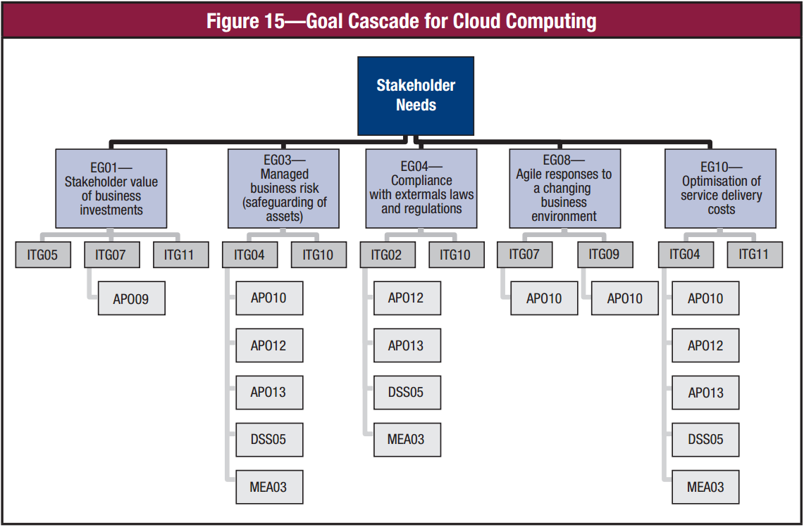
Notes:
Considering the general stakeholder needs for a cloud program (COBIT 5 chapter 1,
compliance with relevant laws, regulations, contractual agreements and internal policies
to protect information confidentiality, integrity and availability), it is fair to identify
enterprise goals EG01, EG03, EG04, EG08 and EG10 in figure 15 as particularly
important in a cloud environment. The example drawing in figure 15 demonstrates
the correlation between cloud enterprise goals, IT goals and the COBIT 5 processes
that must be implemented in a mature way to ensure the achievement of the goals. It is
expanded in figure 16.

Slide 66
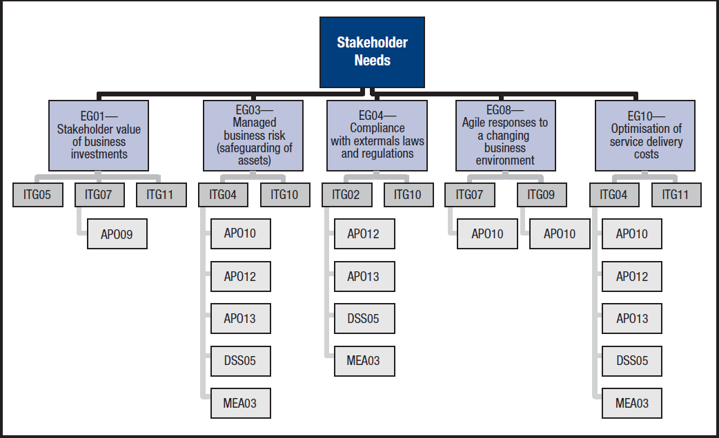
Example: Controls-and-Assurance-Cloud-COBIT-5
Stakeholder Needs

Slide 67
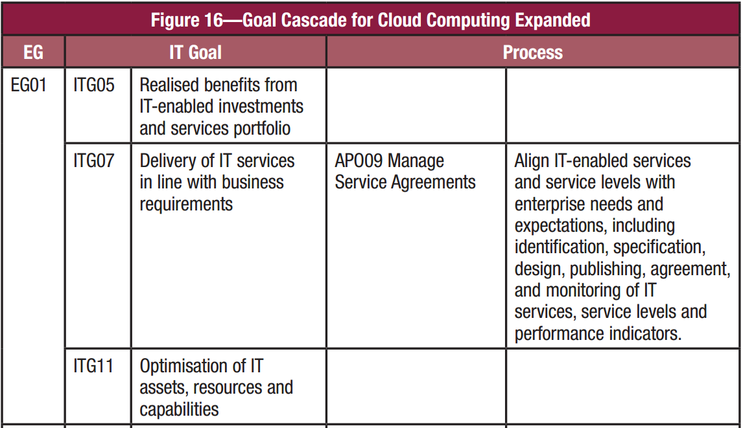

Slide 68
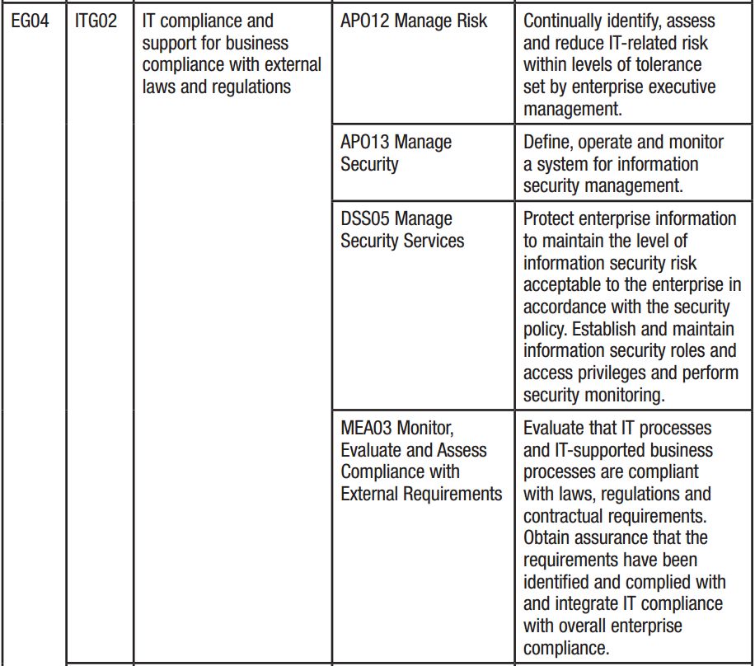

Slide 69
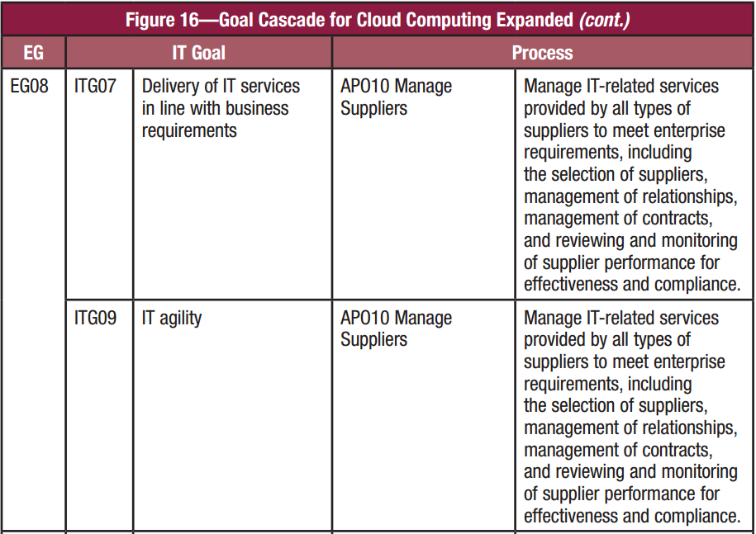

Slide 70
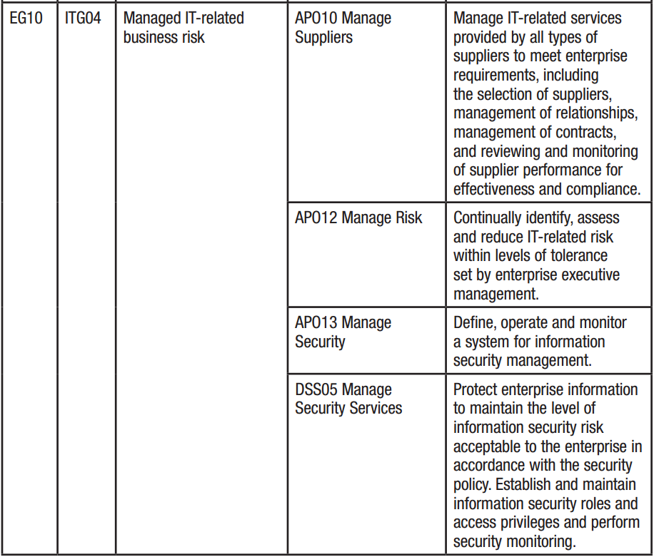

Slide 71
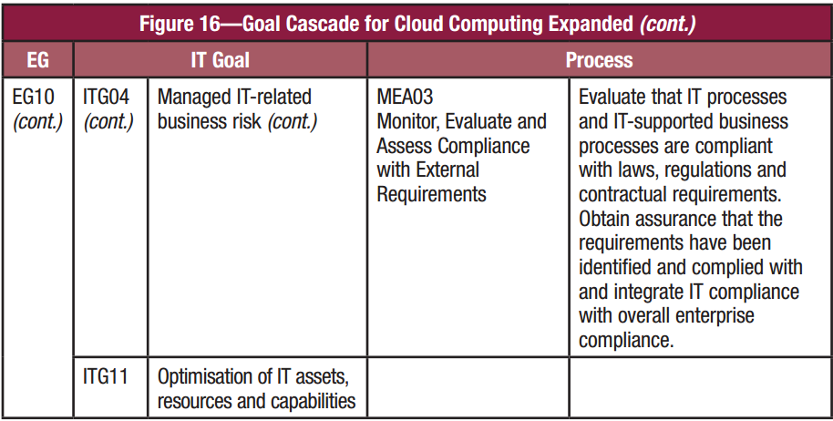

Slide 72
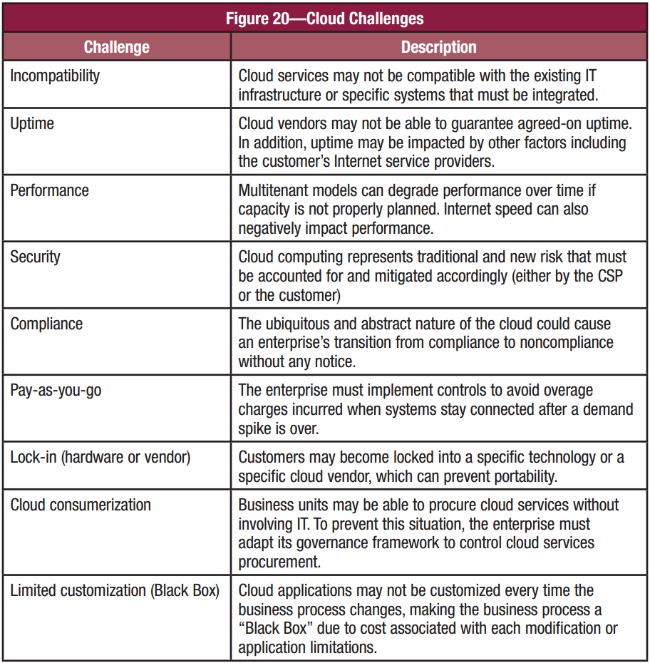

Slide 73
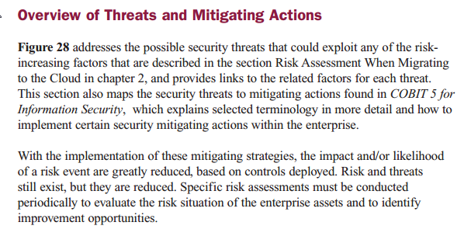

Slide 74
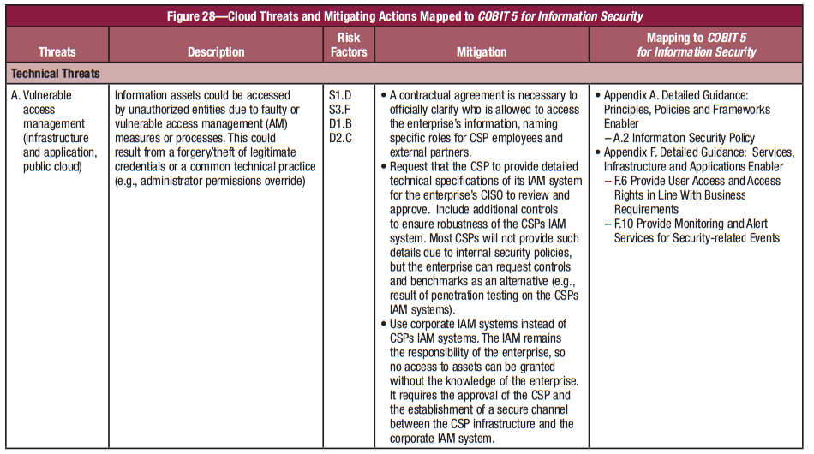

Slide 75
What does cloud change?
Thoughts? Discussion?

Slide 76
Security Program Development
No organization is going to put all the previously listed items (ISO/ IEC 27000, COSO, Zachman, SABSA, CobiT, NIST 800-53, ITIL, Six Sigma, CMMI) in place.
But it is a good toolbox of things you can pull from, and you will find some fit the organization you work in better than others.
You will also find that as your organization’s security program matures, you will see more clearly where these various standards, frameworks, and management components come into play.
Notes:
Security Program Development No organization is going to put all the previously listed items (ISO/ IEC 27000, COSO, Zachman, SABSA, CobiT, NIST 800-53, ITIL, Six Sigma, CMMI) in place. But it is a good toolbox of things you can pull from, and you will find some fit the organization you work in better than others. You will also find that as your organization’s security program matures, you will see more clearly where these various standards, frameworks, and management components come into play.
While these items are separate and distinct, there are basic things that need to be built in for any security program and its corresponding controls . This is because the basic tenets of security are universal no matter if they are being deployed in a corporation, government agency, business, school, or nonprofit organization. Each entity is made up of people, processes, data, and technology and each of these things needs to be protected.
Harris, Shon (2012-11-08). CISSP All-in-One Exam Guide, 6th Edition (Kindle Locations 1738-1744). McGraw-Hill Education. Kindle Edition.

Slide 77
Key Terms Review (1/2)
Security through obscurity -- Relying upon the secrecy or complexity of an item as its security, instead of practicing solid security practices.
ISO/ IEC 27000 series -- Industry-recognized best practices for the development and management of an information security management system.
Zachman framework -- Enterprise architecture framework used to define and understand a business environment developed by John Zachman.
TOGAF -- Enterprise architecture framework used to define and understand a business environment developed by The Open Group.
SABSA framework -- Risk-driven enterprise security architecture that maps to business initiatives, similar to the Zachman framework.
DoDAF -- U.S. Department of Defense architecture framework that ensures interoperability of systems to meet military mission goals.
MODAF -- Architecture framework used mainly in military support missions developed by the British Ministry of Defence.

Slide 78
Key Terms Review (2/2)
CobiT -- Set of control objectives used as a framework for IT governance developed by Information Systems Audit and Control Association (ISACA) and the IT Governance Institute (ITGI).
SP 800-53 -- Set of controls that are used to secure U.S. federal systems developed by NIST.
COSO -- Internal control model used for corporate governance to help prevent fraud developed by the Committee of Sponsoring Organizations (COSO) of the Treadway Commission.
ITIL -- Best practices for information technology services management processes developed by the United Kingdom’s Office of Government Commerce.
Six Sigma -- Business management strategy developed by Motorola with the goal of improving business processes.
Capability Maturity Model Integration (CMMI) -- Process improvement model developed by Carnegie Mellon.

Slide 79
Security Management

Slide 80
Security Management
Security Management is the creation, implementation and maintenance of an organizations security program.

Slide 81
Security Program
A Security Program… the methods a company uses to protect the companies assets
Any good security program should be “top down” with an ultimate goal. This approach management creates the vision and lays out the framework. It does not make sense just to run about locking down machines without a vision. Though this is often how things are actually done.
A security program requires balanced application of Technical and non-technical methods!

Slide 82
Security Program Has…
It includes and we will discuss
Risk Management
Policies, Procedures, Standards, Guidelines, Baselines
Information Classification
Security Education
Security Organization (Positions/Responsibilities)

Slide 83
3 Security Program Goals
All security programs will have goals.. There are 3 main types of goals that you should be aware of
Strategic Goals – long term objectives.
Example: Have all workstations in a domain with centralized security management, auditing, encrypted data access and PKI.
Tactical Goals – mid term goals that help to achieve a final goal.
Example: create managed domain and move all workstations into the domain
Operational Goals – These are DAILY goals, very short term goals.
Example: installs security patch released today.

Slide 84
Understand this
Management is ultimately responsible for security.
NOT administrators
NOT security professionals
Management is ultimately responsible
let me repeat… MANAGEMENT.
Management must lead and direct all security programs. They must provide the vision AND support.
Without their support a security program WILL fail. (a story perhaps?)

Slide 85
More Essential Definitions

Slide 86
Vulnerability
A vulnerability is a lack of a countermeasure or a weakness in a countermeasure that is in place.
It can be a software, hardware, procedural, or human weakness that can be exploited.
A vulnerability may be a service running on a server, unpatched applications or operating systems, an unrestricted wireless access point, an open port on a firewall, lax physical security that allows anyone to enter a server room, or unenforced password management on servers and workstations.

Slide 87
Threat & Threat Agent
A threat is any potential danger that is associated with the exploitation of a vulnerability.
The threat agent is that someone, or something, will identify a specific vulnerability and use it against the company or individual.
The entity that takes advantage of a vulnerability is referred to as a threat agent.
A threat agent could be an intruder accessing the network through a port on the firewall, a process accessing data in a way that violates the security policy, a tornado wiping out a facility, or an employee making an unintentional mistake that could expose confidential information.

Slide 88
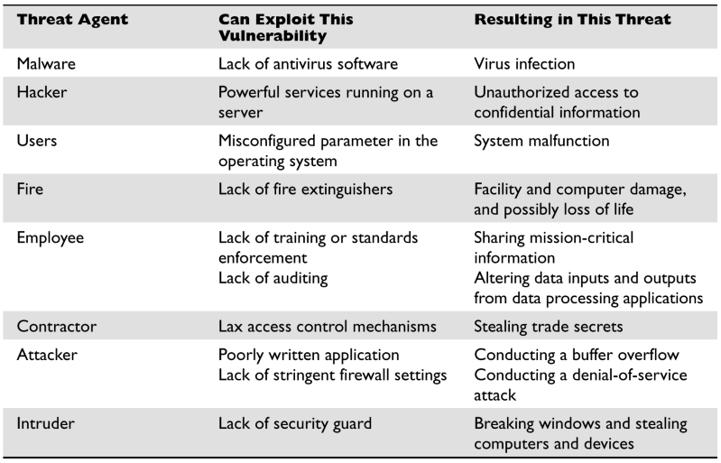
Threat Agent vs. Vulnerability

Slide 89
Risk
A risk is the likelihood of a threat agent exploiting a vulnerability and the corresponding business impact.
If a firewall has several ports open, there is a higher likelihood that an intruder will use one to access the network in an unauthorized method.
If users are not educated on processes and procedures, there is a higher likelihood that an employee will make an unintentional mistake that may destroy data.
If an intrusion detection system (IDS) is not implemented on a network, there is a higher likelihood an attack will go unnoticed until it is too late.
Risk ties the vulnerability, threat, and likelihood of exploitation to the resulting business impact.

Slide 90
Exposure
An exposure is an instance of being exposed to losses.
Something that has business impact.
A vulnerability exposes an organization to possible damages.
If password management is lax and password rules are not enforced, the company is exposed to the possibility of having users’ passwords captured and used in an unauthorized manner.
If a company does not have its wiring inspected and does not put proactive fire prevention steps into place, it exposes itself to potentially devastating fires.

Slide 91
Control
A control, or countermeasure, is put into place to mitigate (reduce) the potential risk.
A countermeasure may be a software configuration, a hardware device, or a procedure that eliminates a vulnerability or that reduces the likelihood a threat agent will be able to exploit a vulnerability.
Examples of countermeasures include strong password management, firewalls, a security guard, access control mechanisms, encryption, and security-awareness training.

Slide 92
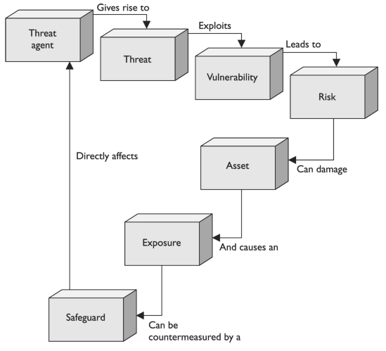
Relationship between Security Concepts

Slide 93
Key Terms – Summary of Security Concepts
Vulnerability -- Weakness or a lack of a countermeasure.
Threat agent -- Entity that can exploit a vulnerability.
Threat -- The danger of a threat agent exploiting a vulnerability.
Risk -- The probability of a threat agent exploiting a vulnerability and the associated impact.
Control -- Safeguard that is put in place to reduce a risk, also called a countermeasure.
Exposure -- Presence of a vulnerability, which exposes the organization to a threat.

Slide 94
Information Risk Management

Slide 95
Gartner Research
Gartner For Technical Professionals - Comparing Methodologies for IT Risk Assessment and Analysis
Authors: Ben Tomhave, Erik T. Heidt & Anne Elizabeth Robins
In-Scope Methods: FAIR; ISACA COBIT 5; ISF IRAM; ISO/IEC 31000:2009 and 27005:2011; MAGERIT; NIST Special Publication 800-30; OCTAVE Allegro; RiskSafe
Summary of Findings (page 3) Bottom Line: Which method you choose for IT risk assessment and risk analysis is far less important than ensuring that the selected methodology is operationalized and a good fit for the corporate culture. It is more important to start somewhere, getting a process in place that integrates with existing or emerging risk management processes, and then scaling and evolving practices over time. The selected approach must be able to produce output that is meaningful to management, and supporting processes must account for assumptions, documentation and potential gaming of the system. Tools should be leveraged, where possible, to ease method adoption.

Slide 96
RMF Gold Standard: SP 800-30
NIST developed a risk methodology, which is published in their SP 800-30 document.
This NIST methodology is named a “Risk Management Guide for Information Technology Systems” and is considered a U.S. federal government standard.
It is specific to IT threats and how they relate to information security risks.
It lays out the following steps: • System characterization • Threat identification • Vulnerability identification • Control analysis • Likelihood determination • Impact analysis • Risk determination • Control recommendations • Results documentation
Notes:
NIST developed a risk methodology, which is published in their SP 800-30 document. This NIST methodology is named a “Risk Management Guide for Information Technology Systems” and is considered a U.S. federal government standard. It is specific to IT threats and how they relate to information security risks. It lays out the following steps: • System characterization • Threat identification • Vulnerability identification • Control analysis • Likelihood determination • Impact analysis • Risk determination • Control recommendations • Results documentation
Harris, Shon (2012-11-08). CISSP All-in-One Exam Guide, 6th Edition (Kindle Locations 2060-2065). McGraw-Hill Education. Kindle Edition.

Slide 97
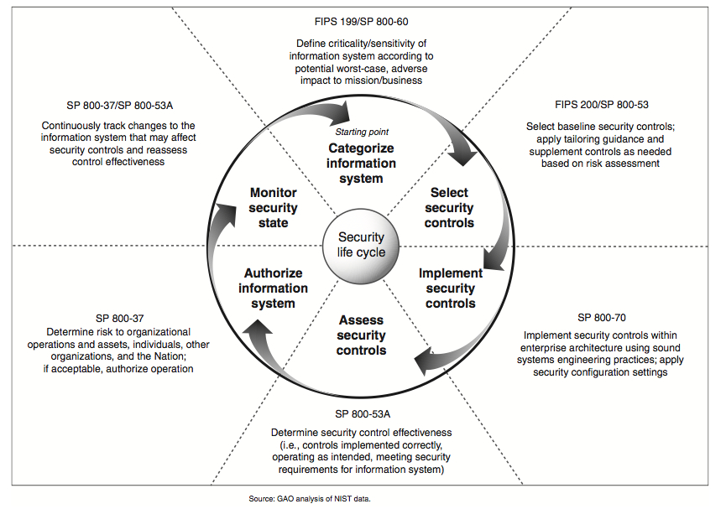

Slide 98
Information Risk Management
IRM is the process of identifying and assessing risk and reducing it to an acceptable level*
There is no such thing as 100% security!*
You must identify risks and mitigate them with either countermeasure or by transferring risk.
Risk is impossible to totally measure, but we must prioritize the risks and attempt to address them!

Slide 99
What are risks*
Some types of risk
Physical Damage
Human Interaction (accidental or intentional action)
Equipment malfunction
Inside and Outsides attacks
Misuse of Data
Loss of Data
Application Error

Slide 100
Information Risk management
IRM is ultimately the responsibility of management *
All organizations should have an IRM policy.
The IRM policy should support the organizations mission.
All organizations should have an IRM team.
IRM should be a subset of the companies total Risk Management Policy.

Slide 101
IRM
Goal of IRM is to ensure the company is protected in the most cost effective manner!

Slide 102
Countermeasure or Safeguard
Some control or countermeasure put into place to mitigate the potential risk. A countermeasure reduces the possibility that a threat agent will be able to exploit a vulnerability.
You can NEVER 100% safeguard something*

Slide 103
Risk Analysis

Slide 104
Risk Analysis
IRM team will need to analyze risk. But is risk analysis?
A tool for risk management, which identifies assets, vulnerabilities and threats.
Access possible damage and determine where to implement safeguards

Slide 105
Risk Analysis Goals
Identify assets and their values
Identify Vulnerabilities and threats
Quantify the probability of damage and cost of damage
Implement cost effective countermeasures!
ULTIMATE GOAL is to be cost effective.
What does that mean exactly?

Slide 106
Value of information and assets?
It is important to understand an assets value if you plan on doing risk analysis. So what is something worth?
Note value can be measured both quantitatively and qualitatively

Slide 107
2 types of analysis
Quantitative analysis
Qualitative analysis
Lets talk in detail about Qualitative vs. Quantitative specifically in the next couple slides

Slide 108
Quantitative Risk Analysis

Slide 109
Quantitative
Quantitative analysis attempts to assign real values to all elements of the risk analysis process. Including
Asset value
Safeguards' costs
Threat frequency
Probability of incident
(more)

Slide 110
Quantitative Analysis
Purely quantitative risk analysis is impossible as there are always unknown values, and there are always “qualitative” values.
Examples?
You can automate quantitative analysis with software and tools. These require tons of data to be collected though, as such require along time and effort to complete.

Slide 111
Overview of steps in a quantitative analysis
Assign value to an asset
Estimate potential loss for each asset and threat combination. (see SLE later)
Perform a threat analysis – determine the probability of each threat occurring.
Derive the Overall loss potential per threat per year.
Reduce, Transfer Avoid or Accept the Risk.

Slide 112
Steps in Quantitative Analysis
Now lets’ break each step out more

Slide 113
Step 1: Assign value to assets
What is something worth?
Cost to obtain
Money an asset brings in
Value to competitors
Cost to re-create
Legal liabilities
Etc…
At the end of step one we must be able to assign a value to each asset.

Slide 114
Step 2: Estimate Loss Potential
For each asset/vulnerability combination we need how much an instance of damage would cost us.
Physical damage
Loss of productivity
Cost of repairing
The expected percentage of damage of the total asset value is called the Exposure Factor (EF)

Slide 115
Step 2:Estimate Loss Potential
The expected percentage of damage of the total asset value is called the Exposure Factor (EF)*
Example:
If you have a warehouse with $1,000,000 of value, and the threat is a fires, your fire suppression systems might stop a fire at 25%, this is your EF.

Slide 116
Step 2: Estimate Loss Potential
Once we have the EF we use it to determine the Single Loss Expectancy (SLE) of an incident.
SLE= asset value * EF

Slide 117
Step 2: Estimate Loss Potential
In the warehouse / fire example
SLE= asset value * EF
asset value was $1,000,000
EF was 25% (.25)
SLE= $1,000,000 * .25
SLE= $250,000

Slide 118
Step 3: Perform a Threat Analysis
Figure out the likely hood of an incident.
Analyze vulnerabilities and rate of exploits.
Analyze probabilities of natural disasters to your location
Review old records of incidents.
In this step we need to calculate the Annualized Rate of Occurrence (ARO)*
Example: chance of a fire in any month=10% then the ARO = .10 * 12 (1 year) So we can expect an ARO=1.2

Slide 119
Step 4: Derive the ALE
Derive the Annual Loss Expectancy
ALE = SLE * ARO
Example:
The ALE for the warehouse fire is
ALE=SLE * ARO
SLE = $250,000
ARO = 1.2
ALE = $250,000 * 1.2
ALE = $300,000
Be able to do these calculation for the *exam
* CISSP exam if you take it later☺

Slide 120
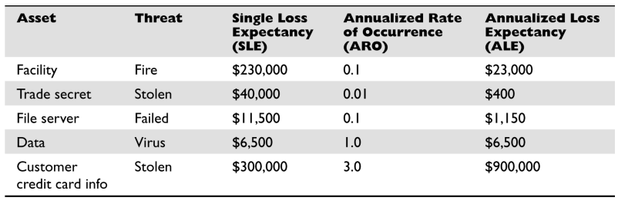
SLE and ALE

Slide 121
Step 5: Reduce, Transfer, Avoid or Accept the Risk
For each risk you can do the following
Reduce risk*
Install countermeasures to reduce ARO or EF
Transfer Risk*
Accept Risk*
Avoid Risk*

Slide 122
Determining Cost Effective Countermeasures
When determining whether to implement an countermeasure, you MUST be concerned about being cost effective.

Slide 123
Determining Cost Effective Countermeasures
Here is how we determine whether a countermeasure is cost effective

Slide 124
Determining Cost Effective Countermeasures
Compute the ALE without the countermeasure in question
Compute ALE2 which is the ALE after installing the countermeasure
Add the cost of the countermeasure to ALE2
Compare ALE to ALE2
If ALE > ALE2 then the countermeasure is cost effective

Slide 125
Word Problem
Details:
The probability of a virus infection per month is 50%.
If an outbreak occurred your sales staff of 5, would not be able to work for the 4 hours while the systems were rebuilt. Each sales person makes $40/hour.
IT would require 1 person 4 hours to repair at a cost of $50/hour.
A certain antivirus system could stop ALL viruses (ok, that’s just to make the math easier) but the cost is 20K per year for this system.
Questions:
Should you implement the Anti-virus system?
If so how much are you saving?
If not how much are you wasting by buying it?

Slide 126
Word Problem Answer
Step 1: Determine SLE
(5 sales * 4 hours each * $40) + (1 IT * 4 hours * 50) = $1000 cost per incident
Step 2: Determine ARO
ARO = 12 months * .50 likelihood per month= 6
Step 3: Determine ALE
ALE = SLE ($1000) * ARO (6) =
ALE = $6000.00

Slide 127
Word Problem Answer
ALE without countermeasure was determined to be $6000
Compute ALE2
ALE2 (ALE after countermeasure) = $0.00
Countermeasure cost = $20,000
ALE2 + countermeasure cost = ($0) + $20,000.00
ALE2 = $20,000
Which is smaller?
ALE ($6,000) or ALE2 ($20,000)

Slide 128
Word Problem Answer
In this case it is NOT cost effective to implement the countermeasure.

Slide 129
Details of Reducing Risk
If the cost per year of the countermeasure is more than the ALE, don’t implement it, instead either:
Transfer the risk
Avoid the risk
Accept the risk

Slide 130
Total Risk vs. Residual Risk (100)
No matter what controls you place to protect an asset, it will never be 100% secure. The leftover risk after applying countermeasures is called the residual risk.
Total Risk is the risk a company faces if they choose accept the risk.

Slide 131
Total Risk vs. Residual Risk (100)
A control gap is the protection a countermeasure cannot provide and therefore = Residual risk
Conceptual (not actual) formulas
Threats x vulnerabilities x asset value = total risk
(threats x vuln x asset value) + control gap = residual risk
Total risk – countermeasures = residual risk
Countermeasures + control gap = total risk

Slide 132
Review of Quantitative
Assign value to assets
Estimate potential loss per asset/threat (SLE)
Estimate likelihood of threat (ARO)
Estimate Annual Loss per year (ALE)
Examine available countermeasures and compute the new ALE + countermeasure cost (ALE2) after each is applied
Determine whether to reduce, transfer, avoid or accept Risk

Slide 133
Qualitative Risk Analysis

Slide 134
Qualitative Risk Analysis (91)
Rather than assign values to everything uses subjective methods to analyze risk and determined methods of managing the risk.
Techniques includes
Judgment
Best practices
Intuition
Experience

Slide 135
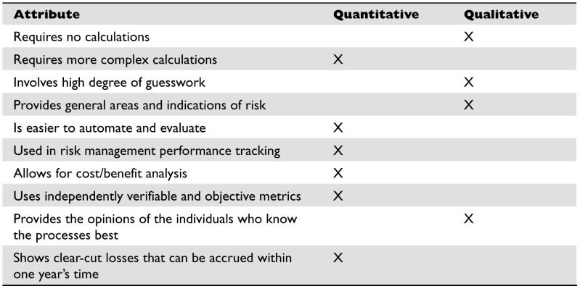
Quantitative vs. Qualitative

Slide 136
Qualitative
Specific techniques we will discuss include
Delphi
Brainstorming
Focus groups
Surveys
Questionnaires
Interviews and one-on-one meetings

Slide 137
Delphi
Technique where a groups comes together, each member gives an honest opinion of what he or she believes the result of a threat will be.
Idea is to have everyone express their true ideas and not just go along with one person dictates
The results are then compiles and given to group members that ANONYMOUSLY write down there comments and returned to analysis group.
These comments are compiled and redistributed for comments until a consensus is reached

Slide 138
Modified Delphi
A silent form of brainstorming , participants develop idea individually without a group and submit their ideas to decision makers.

Slide 139
Other Qualitative Methods
Brainstorming -
a conference technique of solving specific problems, amassing information, stimulating creative thinking, developing new ideas, etc., by unrestrained and spontaneous participation in discussion.
http://dictionary.reference.com/browse/brainstorming

Slide 140
Other Qualitative Methods
Focus groups –
a representative group of people questioned together about their opinions on political issues, consumer products, etc.
http://dictionary.reference.com/browse/focus+group

Slide 141
Other Qualitative Methods
Surveys
Questionnaires
Interviews and one-on-one meetings

Slide 142
Key Terms Review
Quantitative risk analysis -- Assigning monetary and numeric values to all the data elements of a risk assessment.
Qualitative risk analysis -- Opinion -based method of analyzing risk with the use of scenarios and ratings.
Single loss expectancy -- One instance of an expected loss if a specific vulnerability is exploited and how it affects a single asset. Asset Value × Exposure Factor = SLE.
Annualized loss expectancy -- Annual expected loss if a specific vulnerability is exploited and how it affects a single asset. SLE × ARO = ALE.
Uncertainty analysis -- Assigning confidence level values to data elements.
Delphi method -- Data collection method that happens in an anonymous fashion.
Cost/ benefit analysis -- Calculating the value of a control. (ALE before implementing a control) – (ALE after implementing a control) – (annual cost of control) = value of control.
Functionality versus effectiveness of control -- Functionality is what a control does , and its effectiveness is how well the control does it.
Total risk -- Full risk amount before a control is put into place. Threats × vulnerabilities × assets = total risk.
Residual risk -- Risk that remains after implementing a control. Threats × vulnerabilities × assets × (control gap) = residual risk.
Handling risk -- Accept, transfer, mitigate, avoid.

Slide 143
Policies, Standards, Baselines, Guidelines, and Procedures

Slide 144
Policies Standards, Baselines, Guidelines and Procedures
A security program must have all the pieces necessary to provide overall protection to a company and lay out a long term strategy. Policies, Standards, Baselines, Guidelines and Procedures are part of the security program
You NEED to understand the terms in the following slides for the exam. (Polices, standards, baseline, guidelines and procedures)

Slide 145
Security Policy
An overall GENERAL statement provided by senior management.
Very generic
Provides “missions statement for security”
Should represent business objectives
Should be easily understood
It should be developed at integrate security into ALL business functions and processes*
(more)

Slide 146
Security Policy
It should be reviewed an modified as a company changes.
Policy should be dated and version controlled.
It should be forward thinking
It should use strong language (MUST, not should)
Should be non-technical

Slide 147
Security Policy
Can be one of four types
Regulatory – ensures an organization is following required regulations (finance, health)
Advisory – strongly advises employees as to which types of behaviors should/should not take place
Informative – informs employees of goals and missions relevant to a company, not specific or enforceable
Directive

Slide 148
System Specific Security Policy
An organization security policy needs to be technology and solution independent.. it outlines the goals and missions.. NOT specific ways of accomplishing them.
A systems specific policy represents the managements decision on SPECIFIC technologies and situations. These outline for example password policies or data encryption policies. These system specific polices are the structure that provides the support for the organizational security policy.

Slide 149
Standards
Standards are MANDATORY* actions or rules.
Defines compulsory* rules.
Standards give a policy it’s support and start adding specifics.
Example:
a standard is “all employees MUST wear their company ID badge at all times”

Slide 150
Baselines
The process of establishing a minimum set of protections for a computer system/network in order to protect it attack from the hordes of script-kiddies and crackers.
MINIMUM set of protections and configurations

Slide 151
Baseline
Example: a baseline my require that a system be compliant to some external measurement. Any systems must meet these requirements, changes to the system must be assessed to ensure the baseline is still being met.

Slide 152
Baseline
A baseline may also be a technical definition or configuration of a system.
Examples:
a baseline my specify that all windows XP systems must have SP2 installed, and ISS turned off.
a baseline may also specify all Linux systems run SElinux in enforcing mode.

Slide 153
Baseline
Why are baselines important?

Slide 154
Guidelines
Guidelines are RECOMMENDED actions.
These cover the gray areas and are approaches to provide flexibility for unforeseen things.
The are not specific rules, but best practices.
Can someone provide an example of a guideline?

Slide 155
Procedures
Detailed step-by-step tasks that should be performed in some situation.
Lowest level In the policy as they are closest to users and resources.
Procedures spell out how policy, standards and guidelines will be implemented for a specific resources (ex. OS)
Example:
written procedures on OS installation and configuration.

Slide 156
Key Terms Review
Policy -- High-level document that outlines senior management’s security directives.
Policy types -- Organizational (master), issue-specific, system-specific.
Policy functionality types -- Regulatory, advisory, informative.
Standard -- Compulsory rules that support the security policies.
Guideline -- Suggestions and best practices.
Procedures -- Step-by-step implementation instructions.

Slide 157
Setting up the Risk Management Program

Slide 158
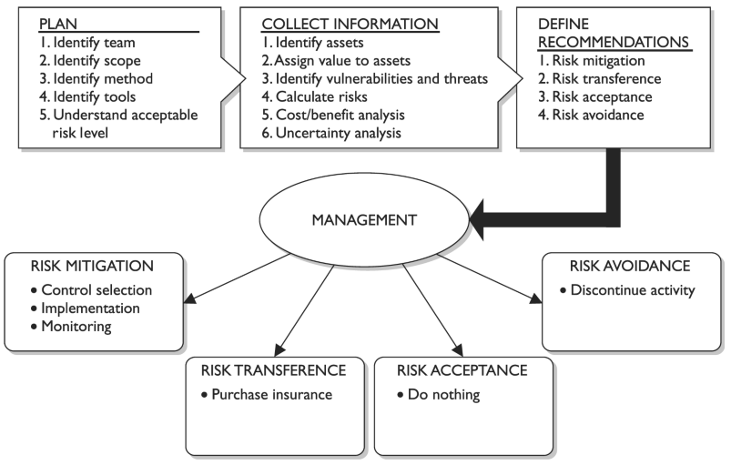

Slide 159
Functionality and Effectiveness of Countermeasures

Slide 160
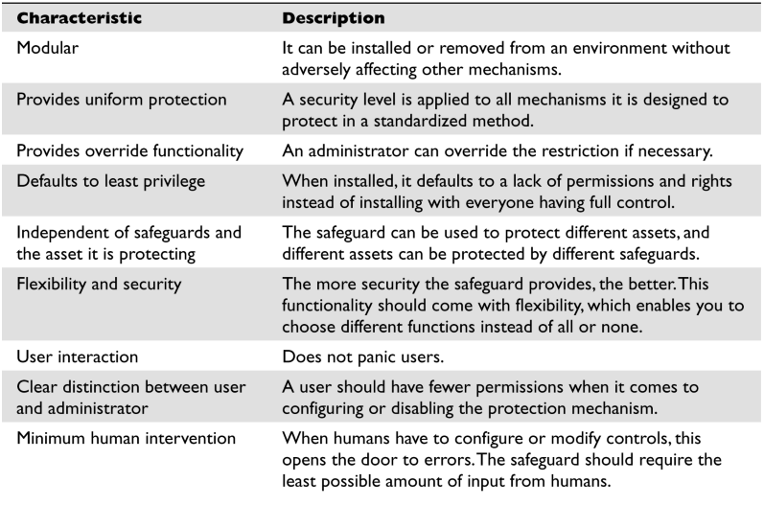
Key Considerations – Characteristics

Slide 161
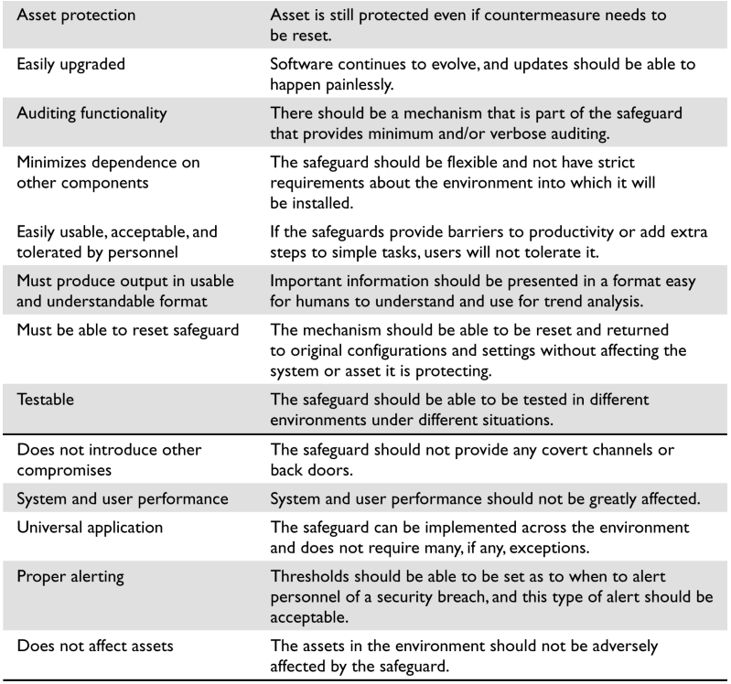

Slide 162
Information Classification

Slide 163
Information Classification
We need to be able to assign value to information, this is Information Classification.
Data is classified to ensure data is protected in a COST-EFFECTIVE manner.
Each classification should have separate handing requirements.

Slide 164
Classification Controls
Once data is classified we must take measures in order to protect and manage the data
Access controls
Encryption of data in transit and at rest
Data access should be logged and audited
Periodically review classifications
Backup and restoration procedures
Change Control procedures
Proper data disposals

Slide 165
Positions and Responsibilities

Slide 166
Positions and Responsibilities
Senior management is obviously ULTIMATELY responsible for data security, risk management and pretty much everything else. However let’s look at some of the other positions commonly found and see what their responsibilities are.

Slide 167
Data Owner
Data owner is usually a member of management who is in charge of a specific business unit and responsible for that information that such a unit possesses.
Responsible for specifying the classification of data
Responsible for determining necessary controls are in place to protect data

Slide 168
Data Owner
This is a “Business” role
Classifying data or authorizing data access requests
Defining backup requirements (not implementing)
Ensuring security controls are appropriate (not implementing)
Delegates day-to-day maintenance to the “data custodian”
Act on security violation notifications

Slide 169
Data Custodian
The Data Custodian MAINTAINS the data day to day.
Performs backups
Ensures the availability of data.
Validates data integrity
Restores data
Ensures data retention requirements based on what the data owner specifies

Slide 170
Security Administrator
Setup security configurations on a system as defined by the DATA OWNER*
Creates accounts
Sets access rights in support of the policies defined.
Technical position.

Slide 171
Understand this (security administrator)
A security administrators jobs is to ensure the managements directives are fulfilled! They do NOT create security policies
They also do NOT authorize access to data or resources. They are responsible for ensuring the security controls enforce the access levels that have been specified by the data owner or the management’s policies.

Slide 172
Security Analyst
Helps define a security program elements and ensures the elements are being implemented properly by the technical people and procedures.
This is NOT an implementation role
Higher more strategic level.

Slide 173
Supervisor
More of an HR role, you all know what a supervisor does.
Managing employees
Ensuring employees live up to their responsibilities
Handle HR tasks such as hiring, firing and initiating corrective action.
Informing security admin of changes to an employees position.

Slide 174
Data Analyst
Ensures that data is stored in a way that makes the most sense for it’s application.
Specifically considered with information “architecture”, how data is stored in reference to other data, data structures
Work with data owners to ensure the structures support the business objectives.

Slide 175
Process Owner
Are responsible for certain business processes
Examples:
Procurement process
Hiring process
Order fulfillment process

Slide 176
User
Someone who uses the data, day to day to accomplish work tasks and business objectives
Responsible for following data and security procedures that have been laid out by management.

Slide 177
Auditor
Provides a method for independently ensuring that management and shareholders can rely upon the appropriateness of security objectives.
Determines if controls/methods have been reached
Determines if practices are in compliance with company or legal requirements
Should be 3rd party

Slide 178
Administrative Controls and Concepts

Slide 179
Separation of Duties
The idea of ensuring one individual cannot complete a critical task by themselves.
Reduces the possibility for fraud, sabotages, theft or general abuse.
To subvert separation of duties requires collusion* (next page)

Slide 180
Collusion
At least two people working together to subvert the security controls.

Slide 181
Hiring Practices
All employees should have background checks and be screened* (even janitors etc in high security environments)
Everyone MUST sign an NDA, which should protect secrets and conflicts of interest.
Drugs tests
Education checks
Reference checks

Slide 182
Rotation of Duties
Employees should rotate in their duties
Why?
For redundancy
To ensure no-one has too much control over a segment of business

Slide 183
Mandatory Vacations
Employees MUST take vacations
Why?
Gives opportunity for others to discover fraud. If employees don’t want to take a vacation, they might be doing something underhanded and do not want to be found out
Additionally it enforces that other people can step in and that the process cannot be disrupted by that employee being absent for whatever reason.

Slide 184
Split Knowledge
Separation of duties concept. An employee only has enough knowledge to perform part of a task.
Again helps fight fraud.
Example:
Two managers only know their half of a bank vault combination.

Slide 185
Dual Control
Like split knowledge, but in this case two or more people must be available and active to perform an action.
Example:
A bank vault has two separate keys that must be turned at the same time to unlock the vault.

Slide 186
Employee Termination
Companies should have a defined procedure for employee termination, it must be strictly enforced.
Examples policy could be:
Employee must complete an exit interview
Employee must surrender id badges, and keys
Employee accounts must be locked out.
Employee must leave the facility immediately under supervision of a security guard

Slide 187
Security Awareness Training
Any security program MUST provide adequate thought and resources to training.
Security is only as good as the weakest link.
Unless your staff is trained on the importance of security, proper security procedures and concepts, and day to day security operations… you are doomed to fail.
The most expensive and technical controls will be rendered useless by uneducated staff.
Some security threats (etc phishing) can only properly be mitigated by user education

Slide 188
Key Terms
Data owner -- Individual responsible for the protection and classification of a specific data set.
Data custodian -- Individual responsible for implementing and maintaining security controls to meet security requirements outlined by data owner.
Separation of duties -- Preventive administrative control used to ensure one person cannot carry out a critical task alone.
Collusion -- Two or more people working together to carry out fraudulent activities.
Rotation of duties -- Detective administrative control used to uncover potential fraudulent activities.
Mandatory vacation -- Detective administrative control used to uncover potential fraudulent activities by requiring a person to be away from the organization for a period of time.

Slide 189


Notes:
Summary A security program should address issues from a strategic, tactical, and operational view, as shown in Figure 2-17 . The security program should be integrated at every level of the enterprise’s architecture. Security management embodies the administrative and procedural activities necessary to support and protect information and company assets throughout the enterprise. It includes development and enforcement of security policies and their supporting mechanisms: procedures, standards, baselines, and guidelines. It encompasses enterprise security development, risk management, proper countermeasure selection and implementation, governance, and performance measurement.
Harris, Shon (2012-11-08). CISSP All-in-One Exam Guide, 6th Edition (Kindle Locations 3167-3172). McGraw-Hill Education. Kindle Edition.

Slide 190
Final Thoughts

Slide 191
Final Thoughts

Slide 192
From Authorities to Audits
Examples
Technical, physical, and administrative requirements that must be in place to ensure compliance with the authorities
Statements of how a company will implement and enforce requirements
Implementation of the technical, physical, and administrative requirements found in the policy statements
Verification of appropriately implemented controls to comply with requirements
PCI
HIPAA
NERC
Authorities
Requirements
Policies
Controls
Audits
PCI-DSS Example
Authority: PCI-DSS is the authority document created by the PCI-SSC.
Requirement: (10.6) Review logs for all system components at least daily.
Policy: Monitoring Policy – States logs will be reviewed at least daily.
Control: Tool XYZ provides real-time monitoring for all system components.
Audit: Auditor verifies Tool XYZ is appropriately monitoring and alerting to actionable events. Audit results and evidence are stored as part of the audit.

Slide 193
Effectively Managed IT Controls
Technology can affect every part of the business.
At its best, technology is a competitive advantage.
At its worst, technology is your competitor’s advantage.
Product
Market Relationships
IT Controls:
Detective, protective and reactive measures in place to protect the confidentiality, integrity, and availability of business information and ensure appropriate management of the IT function to meet business objectives.
Inbound Logistics
Operations
Outbound Logistics
Marketing
and Sales
Service
Firm Infrastructure
HR Management
Margin
Procurement
Technology Development
Notes:
Compliance Control: A process, effected by management and other personnel, designed to provide reasonable assurance that transactions are executed in accordance with 1) laws governing the use of budget authority and other laws and regulations that could have a direct and material effect on the financial statements or required supplementary stewardship information and 2) any other laws, regulations, and government wide policies identified in OMB audit guidance. [GAO/PCIE Financial Audit Manual]
Source: http://www.unifiedcompliance.com/it_compliance/language_compliance/definitions/c.html

Slide 194
Chris Davis
UTD Email: cmd140430@utdallas.edu
Google Voice: 214-771-8122
Course Materials
https://elearning.utdallas.edu

Slide 195
Additional Materials

Slide 196

Today's Materials
Harris, Shon (2012-11-08).
CISSP All-in-One Exam Guide, 6th Edition.
McGraw-Hill Education.

